Slide 1

UNIVERSITY INSTITUTE OF ENGINEERING
COMPUTER SCIENCE ENGINEERING
Bachelor of Engineering (Computer Science & Engineering)
Subject Name: Big Data Analytics
Subject Code: 20CST-471
Overview of machine learning algorithms
Mapped with CO5
Prepared By:
Er. Ankita Sharma
DISCOVER . LEARN . EMPOWER

Slide 2
Machine learning algorithms form the backbone of artificial intelligence, enabling systems to learn and make predictions or decisions based on data.
Here's an overview of some key types of machine learning algorithms:
1. Supervised Learning:
Definition: In supervised learning, the algorithm is trained on a labeled dataset, where the input data is paired with corresponding output labels.
Examples: Linear Regression, Decision Trees, Support Vector Machines, Neural Networks, Random Forests.
2. Unsupervised Learning:
Definition: Unsupervised learning involves training an algorithm on an unlabeled dataset, and the system tries to find patterns or relationships in the data without explicit guidance.
Examples: K-Means Clustering, Hierarchical Clustering, Principal Component Analysis (PCA), Autoencoders.

Slide 3
3. Semi-Supervised Learning:
Definition: Semi-supervised learning combines elements of both supervised and unsupervised learning. The algorithm is trained on a dataset with both labeled and unlabeled data.
Example: Label Propagation, Self-training.
4. Reinforcement Learning:
Definition: Reinforcement learning involves training an agent to make decisions within an environment by receiving feedback in the form of rewards or penalties.
Examples: Q-Learning, Deep Q Networks (DQN), Policy Gradient Methods.

Slide 4
5. Decision Trees:
Definition: Decision trees are tree-like models where each node represents a decision based on a feature, leading to branches that represent possible outcomes.
Example: Classification and Regression Trees (CART).
6. Random Forests:
Definition: Random Forests are an ensemble learning method that constructs multiple decision trees during training and outputs the mode of the classes as the prediction.
Example: Random Forest for classification and regression.

Slide 5
7. Support Vector Machines (SVM):
Definition: SVM is a supervised learning algorithm used for classification or regression tasks. It finds the hyperplane that best separates classes in a high-dimensional space.
Example: Binary classification, support vector regression.
8. K-Nearest Neighbors (KNN):
Definition: KNN is a simple and intuitive algorithm that classifies a data point based on the majority class of its k nearest neighbors in the feature space.
Example: Classification and regression tasks.

Slide 6
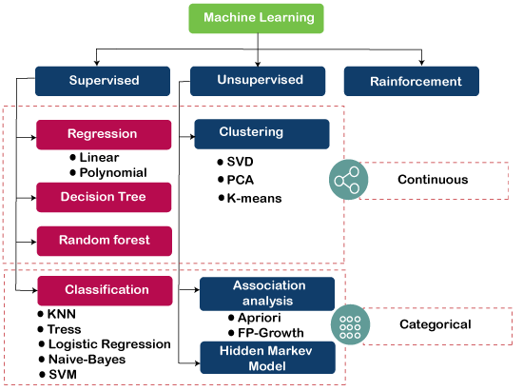

Slide 7
9. Neural Networks:
Definition: Neural networks are computational models inspired by the human brain, consisting of layers of interconnected nodes (neurons).
Examples: Multilayer Perceptron (MLP), Convolutional Neural Networks (CNN), Recurrent Neural Networks (RNN).

Slide 8
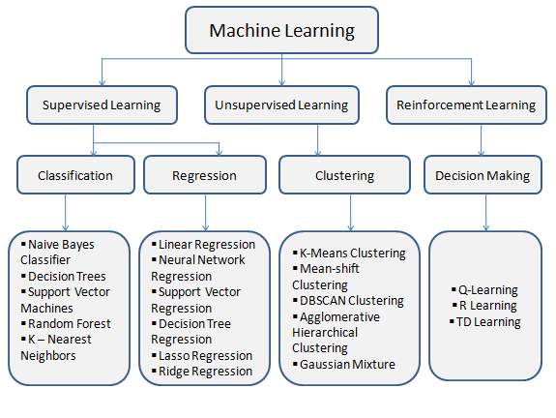

Slide 9
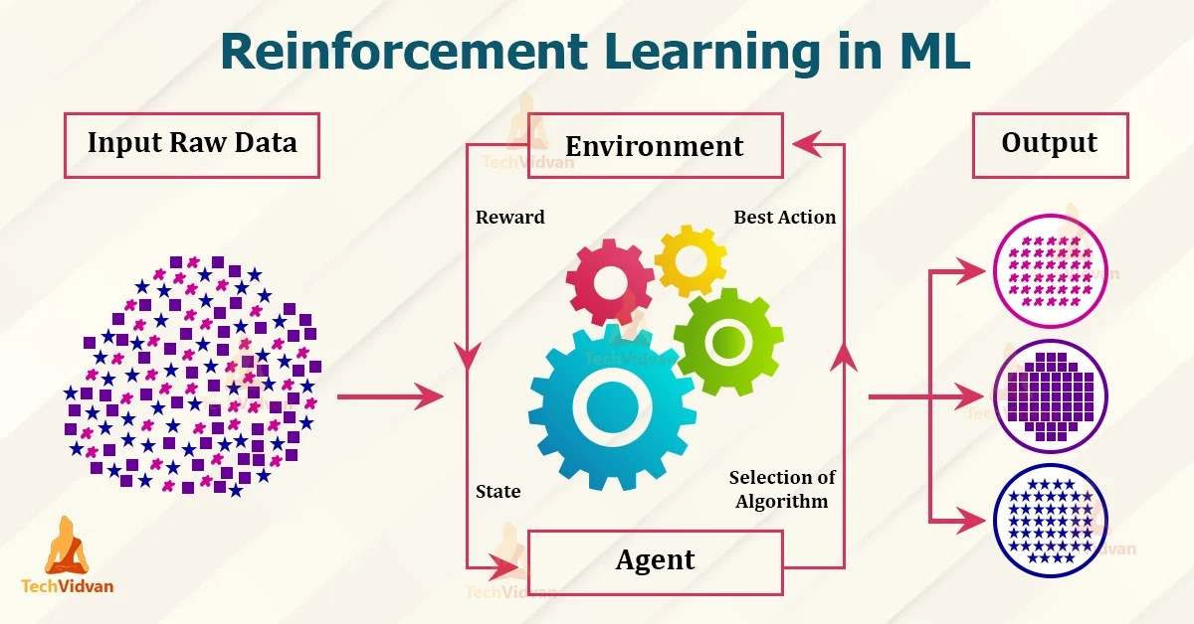

Slide 10
Thankyou

